Slide 1


Strategies For Passing
(mostly) Microsoft
Certification Exams
By George Squillace
January 15, 2018
Notes:
Introduce name
Thank attendees for coming.

Slide 2
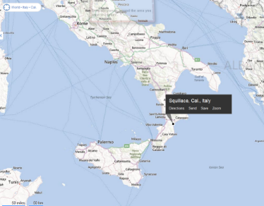



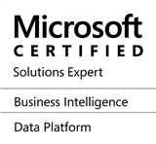





George SQUILLACE
“SQL” is in the name!
Husband & Dad
Twenty Four Years of New Horizons service
(June 2016)
30+ years in Information Technology
Microsoft Certified Trainer (MCT) since 1997
Microsoft SQL Server certifications
  MCSE: Business Intelligence
  MCSE: Data Platform
  MCSA
SQL user group presenter
Microsoft Virtual Academy presenter
SQLSaturday presenter
For fun: (no particular order)
Movies
Reading
Bicycling (road / city / trail)
Travel
Music / Acoustic Guitar
Computers
Aircraft
+ George.Squillace@NHLearningSolutions.com
" www.e-Squillace.com

Slide 3
Agenda
What is certification?
Why should I certify?
How do I certify?
How do I prepare?
Most pictures are hyperlinked leading you to other resources!

Slide 4

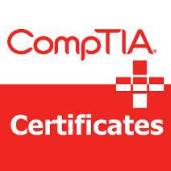



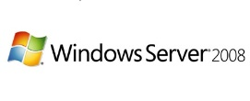


My Qualifications…
Why Listen to Me?
99 exam sittings in the past 24+ years
Passed almost every exam sitting on the first try
(Thank you, dear Lord!)
I’ve taken (and passed) vendor exams from Novell, CompTIA and Microsoft
  (So, my testing experience is not from only one test vendor’s reference point)
I’ve earned a number of certifications from Novell, CompTIA and Microsoft over a range of products
Certified in every version of SQL Server since
SQL Server 2000
Certified in every version of Windows Server from
Windows NT 4.0 – Windows Server 2008
Notes:
30+ years in the industry.
25+ years as a professional trainer.
20+ years as an MCT.
Every version of Windows Server from NT 4.0 through Windows Server 2008
Every version of SQL Server from 2000 – current.
Novell, Master CNI and Master CNE
CompTIA
Passed all seven SQL Server 2012 exams on the first try.
Tonight’s focus: Microsoft certification, and certification on the SQL Server product

Slide 5
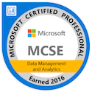
What is Certification?
Certification refers to the confirmation of certain characteristics of an object, person, or organization. This confirmation is often, but not always, provided by some form of external review, education, assessment, or audit.
One of the most common types of certification in modern society is professional certification, where a person is certified as being able to competently complete a job or task, usually by the passing of an examination.
Passing one or more challenging, computer-administered exams
Credit: Wikipedia
Notes:
Validation that you know something and/or can DO something.

Slide 6

Why Certify?
Verify skills / Confidence
Prestige
  Not everyone can pass these exams
  Not everyone is a good test-taker
Job opportunities
  “Those holding an MCSE in the US, earn 17% more, on average, than those not certified.”
Salary / Raise / Bonus / Promotion $$$
Recognition
Learn the product much more thoroughly / find more solutions
Challenge
Certification is not a “golden ticket”
Notes:
A part of you dies if you no longer take risks.
Story about former boss not knowing about FILER.exe in Novell NetWare. He had great street knowledge but almost no formal knowledge.

Slide 7

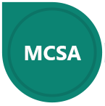

Microsoft Certification Tracks
Microsoft Technology Associate (MTA)
  “…an entry-level certification intended for people seeking knowledge of fundamental technology concepts”
  “…addresses a wide spectrum of basic technical concepts”
Microsoft Certified Solutions Associate (MCSA)
  “…intended for people who seek entry-level jobs in an information technology environment. MCSA is a prerequisite for more advanced Microsoft certifications”
Microsoft Certified Solutions Expert (MCSE)
  Requires a prescribed MCSA certification
  “…intended for IT professionals seeking to demonstrate their ability to build innovative solutions across multiple technologies, both on-premises and in the cloud”
Notes:
This presentation focuses on SQL Server and data-specific certifications from Microsoft.

Slide 8
Data – Related MTA Certification
MTA: Database Fundamentals
  Exam 98-364, Database Fundamentals
  “…candidates for this exam are seeking to prove introductory knowledge of and skills with databases, including relational databases, such as Microsoft SQL Server”
Notes:
The value of this certification is questionable.

Slide 9
Data – Related
MCSA Certifications
MCSA: SQL Server 2012/2014 (three exams)
  Exam 70-461, Querying Microsoft SQL Server 2012/2014Y
  Exam 70-462, Administering Microsoft SQL Server 2012/2014 Databases
  Exam 70-463, Implementing a Data Warehouse with Microsoft SQL Server 2012/2014
MCSA: SQL 2016 Database Administration (two exams)
  Exam 70-764, Administering a SQL Database Infrastructure
  Exam 70-765, Provisioning SQL Databases
MCSA: SQL 2016 Database Development (two exams)
  Exam 70-761, Querying Data with Transact-SQL
  Exam 70-762, Developing SQL Databases
MCSA: SQL 2016 BI Development (two exams)
  Exam 70-767, Implementing a SQL Data Warehouse
  Exam 70-768, Developing SQL Data Models
MCSA: BI Reporting (two exams)
  Exam 70-778, Analyzing and Visualizing Data with Power BI
  Exam 70-779, Analyzing and Visualizing Data with Microsoft Excel (beta)
MCSA: Machine Learning (two exams)
  Exam 70-773, Analyzing Big Data with Microsoft R
  Exam 70-774, Perform Cloud Data Science with Azure Machine Learning
MCSA: Data Engineering with Azure
  Exam 70-775, Perform Data Engineering on Microsoft HD Insight
  Exam 70-776, Perform Big Data Engineering on Microsoft Cloud Services (beta)
Notes:
The primary purpose of this slide is to show the variety of certifications and to provide links to the attendees for those who want to know more.

Slide 10
Data – Related
MCSE Certifications
MCSE: Data Management and Analytics (two exams)
  Earn MCSA (six different MCSAs qualify)
  Pass one of the following exams:
    Exam 70-473, Designing and Implementing Cloud Data Platform Solutions
    Exam 70-475, Designing and Implementing Big Data Analytics Solutions
    Exam 70-464, Developing Microsoft SQL Server Databases
    Exam 70-465, Designing Database Solutions for Microsoft SQL Server
    Exam 70-466, Implementing Data Models and Reports with Microsoft SQL Server
    Exam 70-467, Designing Business Intelligence Solutions with Microsoft SQL Server
    Exam 70-762, Developing SQL Databases
    Exam 70-767, Implementing a Data Warehouse using SQL
    Exam 70-768, Developing SQL Data Models
    Exam 70-773, Analyzing Big Data with Microsoft R
    Exam 70-774, Perform Cloud Data Science with Azure Machine Learning
    Exam 70-775, Perform Data Engineering on Microsoft Azure HDInsight

Slide 11
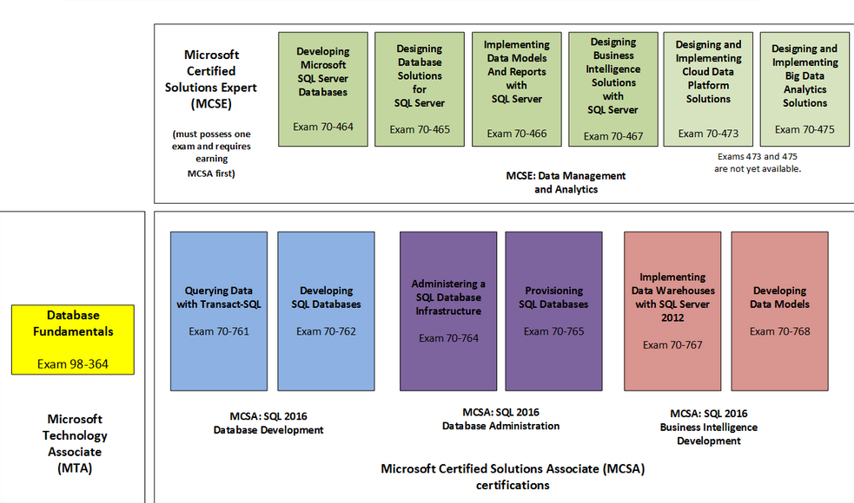
SQL Server 2016 Certifications
(partial certification list)
MTA
MCSA
MCSE
Notes:
The purpose of this slide is to show a “big picture” of most of the modern certifications.

Slide 12
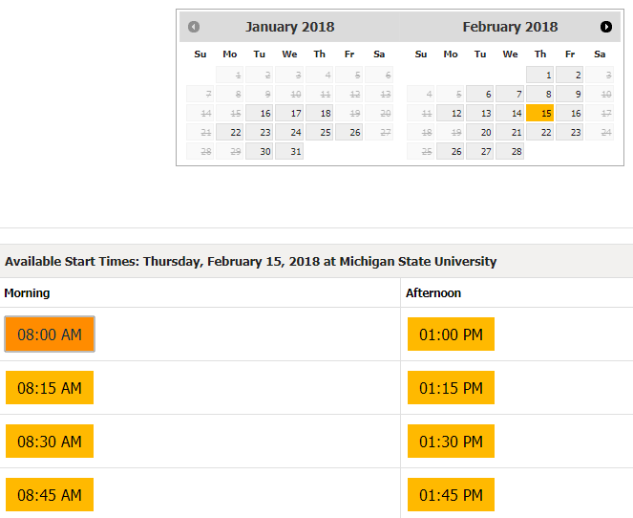
So, You’ve Decided to Certify:
Test Registration Details
Pearson Vue website
Determine testing location
  Remote testing is now available
Determine desired timeframe
  Morning
  Afternoon
Fees
  Example, $165 for the Power BI exam
  Keep an eye out for promotions
  Payment types
    Voucher
    Credit Card
Identification (two forms required)
  Government ID with name, photo, and signature
  Secondary form with name and signature
Select exam time

Slide 13
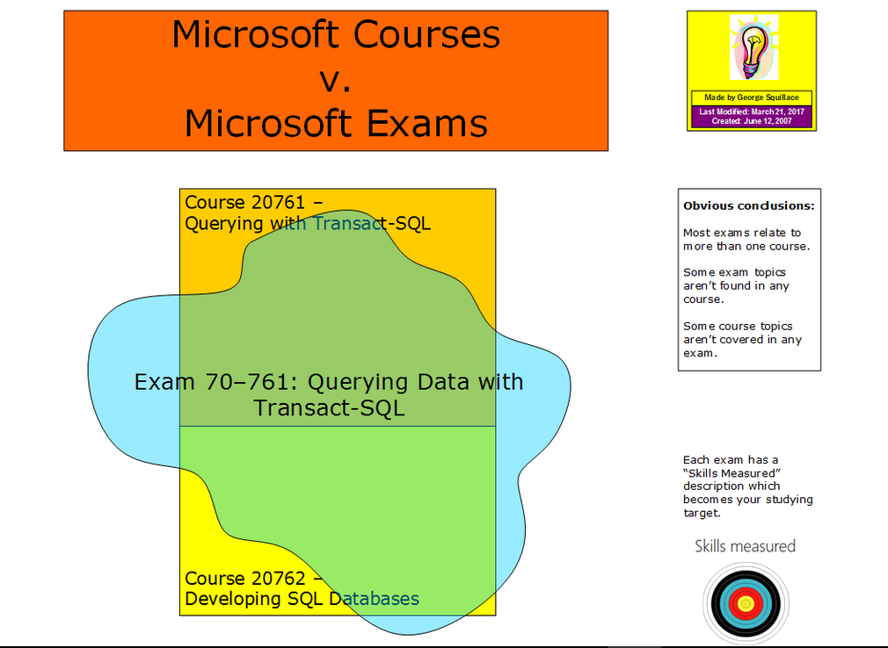

Slide 14


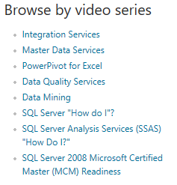
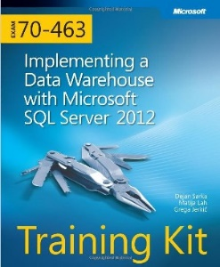
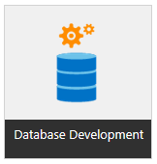
Preparation Resources
Exam preparation guide
(a.k.a. “Skills Measured”)
  Microsoft Learning website
Microsoft Official Courses
(at New Horizons)
Forums, such as TechNet
Microsoft TechNet videos
Microsoft Virtual Academy videos
Test preparation “Training Kits”
(for the SQL 2012/2014 exams)
Test preparation software
  See upcoming slides
Notes:
Geo, use the hyperlinks, in particular for the “Skills Measured” link.
Every exam has a “Preparation options” section with a list of related courses.
Test preparation kits often come with sample test questions, but not the same quality as the test preparation vendors.

Slide 15
Test Preparation Software, Part 1
Test preparation software can be very helpful…
  …the harder the exam
  …the newer you are to testing
  …the more anxiety you have
  …the newer you are to the subject matter
Cost, $100 < x < $150 per exam
Preparation exams are very often harder than the actual exam
Consider persuading your employer to cover the exam and preparation s’ware costs
Sometimes abbreviated sample exams are available for free
Notes:
At times these purchases are a great investment.
They still don’t guarantee pasing the exam.
The quality of these preparation exams vary by software vendor and exam!

Slide 16
Test Preparation Software, Part 2
There are at least two test prep software deployment methods
    Web-based
      Connect to a subscription-based website, providing (for example) a six month preparation time window
      Advantage: Allows you to connect anywhere, as long as you have a live connection
    Local executable
      Install a program to your local computer
        Transcender
      Advantage: Allows you to prepare anywhere, as long as you have the computer where you installed the software
Test Prep Tip #1: Take five question tests while preparing
Test Prep Tip #2: Take one test with every question and the answers and print the results with the answers to PDF
Test Prep Tip #3: Don’t worry about completing all of the questions; I don’t generally visit even half the questions but I’m still properly prepared
Notes:
These products aim to closely simulate the vendor exams.
None of them are perfect.

Slide 17
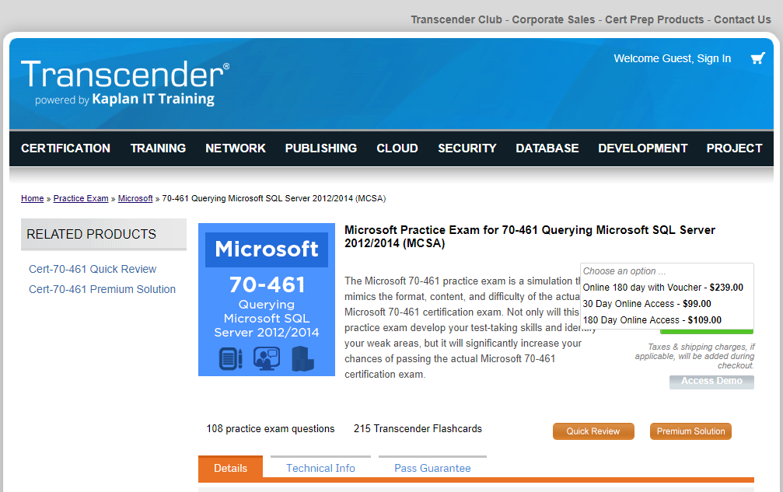
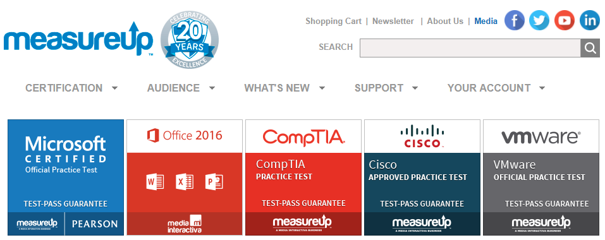
Test Preparation Software, Part 3
Notes:
I tend to prefer Transcender more than the others.

Slide 18

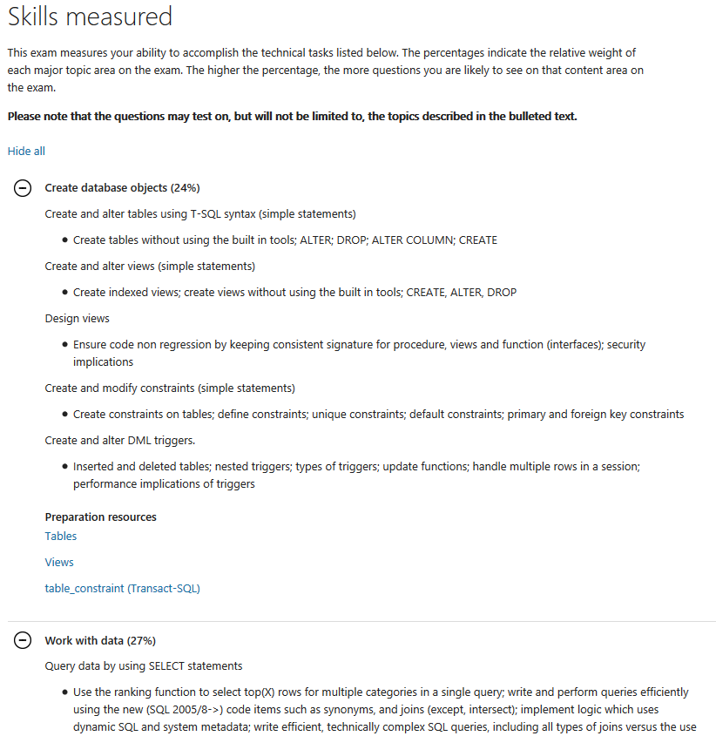
Study Tip #1: Know Your Target
(Exam Objectives)
How are the test objectives located?
Emphasize study of newer features
Really…do I have to know ALL of that material?
Notes:
The test objectives are located in the Skills Measured section of an exam’s details, found at www.Microsoft.com/Learning.
Really…do I have to know ALL of that material? No. Never ONCE could I say I have every single topic fully prepared.
Aim to have a clue about every topic, at least its context.

Slide 19
Study Tip #2:
Managing the Volume of Material
In regard to each product feature ask, “Is this a feature or skill every administrator / developer should know?”
Concentrate on those features

Slide 20
Study Tip #3:
You’ll Never Feel Ready Enough
So, schedule your exam now
You can always postpone a day or two or more
For what it’s worth, near panic sets in a day or two before I take my test because I know I need to know more and better. I’ve learned to expect this (and my family gives me a lot of room then also)

Slide 21
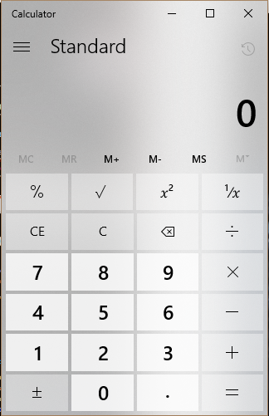
What to Expect in the Testing Booth
Can
  Marker board and pens
  Windows Calculator
  Use the restroom during the test
Can’t (no personal items)
  “You will not be allowed to take any personal items with you into the testing room. This includes all bags or purses, books, notes, personal computers or devices, cell phones, pagers, watches and wallets.”
Dress for all temperatures
There may be multiple people in the testing room
Expect being viewed by camera remotely
Expect quiet
Required passing score and total points presented at the beginning of the exam
Tip #4: At the beginning of the exam calculate the points per question to determine the number of questions you must score correctly to obtain a passing score
Exam score/outcome is immediately reported and printed

Slide 22
Test Question Formats
Active Screen (interact with a complex dialog box, make appropriate choices)
Build List (from a list of objects on the left pane need to be dragged into the right pane in the correct order)
Case Studies (lengthy scenario, multiple questions, often include exhibits, often separately timed)
Create-a-Tree
Drag and Drop
Hot Area
Multiple Choice (sometimes the number of correct answers is provided, other times not)
Repeated Answer Choices (same, large number of answers repeated over several questions)
Simulations (portion wizard walkthrough)
Short Answer Code (type programming code, key word list may be available)
Best Answer (multiple choice, only one correct answer)
Click here for short videos on what each of these look like
  Scroll down a bit more to see how exams are developed and modified
Notes:
Video links to very short presentations on each of these formats
https://www.microsoft.com/learning/en-us/certification-exams.aspx

Slide 23
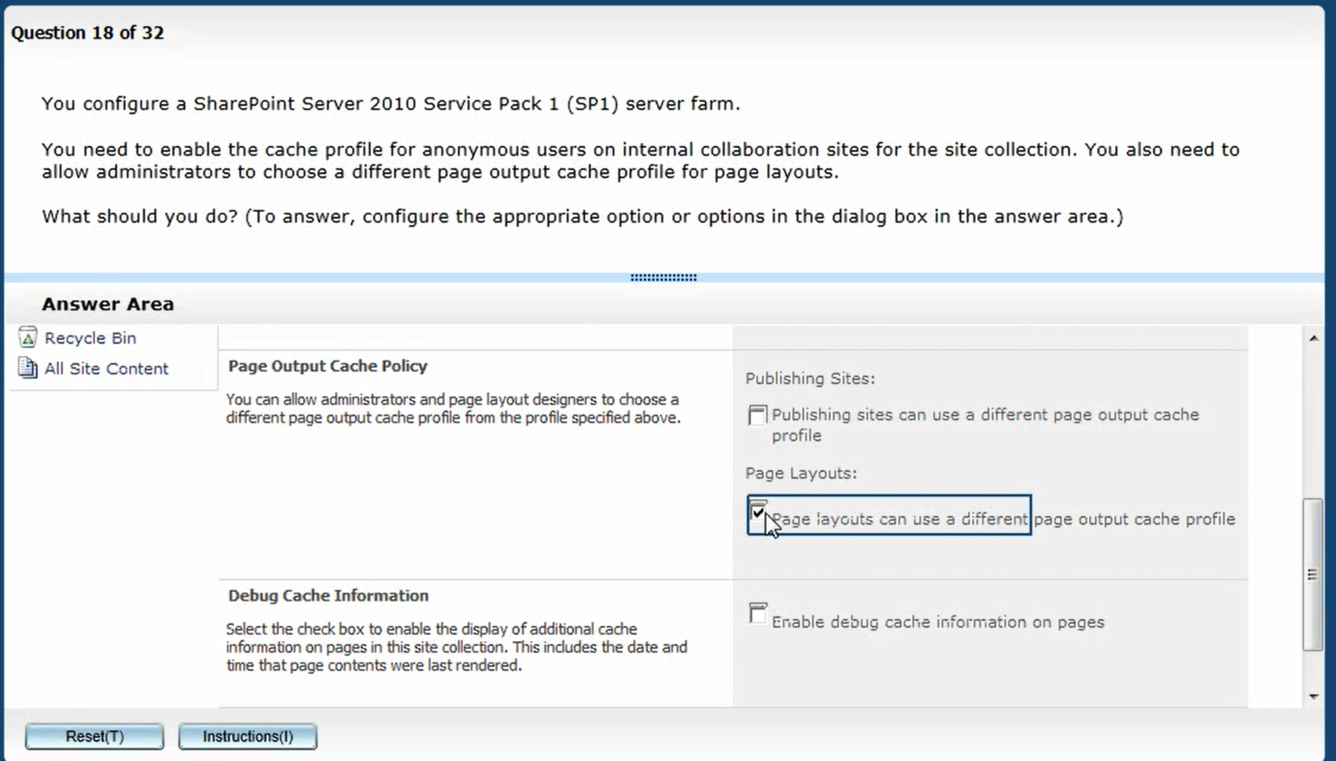
Test Question Format
Active Screen

Slide 24
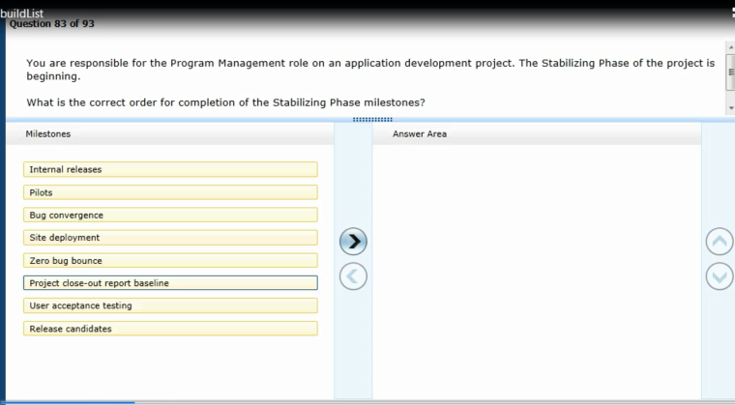
Test Question Format
Build List

Slide 25
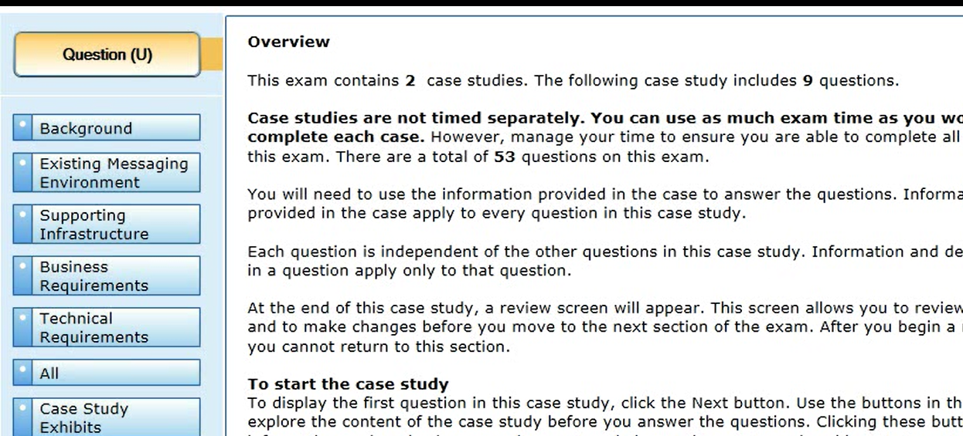
Test Question Format
Case Study
They have a “story problem” format with 5-8 questions
This is the primary format for design exams
Irrelevant information is often included (just like the real world)
Case study question series are often separately timed
Often cannot return to review these questions

Slide 26
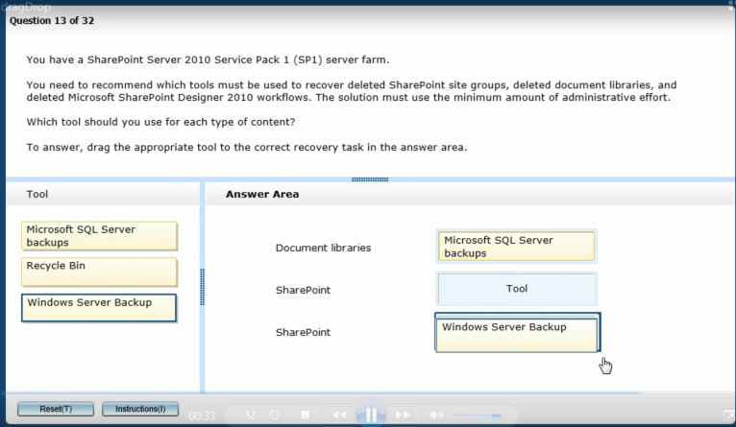
Test Question Format
Drag and Drop

Slide 27
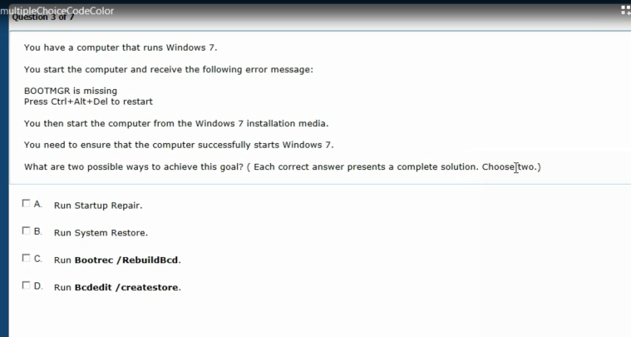
Test Question Format
Multiple Choice

Slide 28
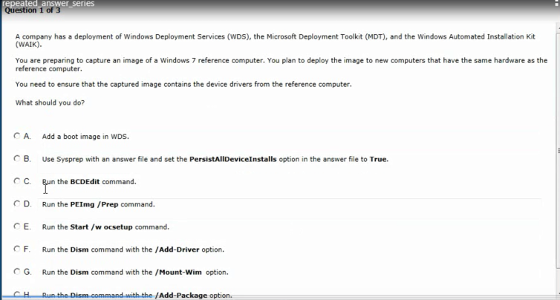
Test Question Format
Repeated Answer

Slide 29
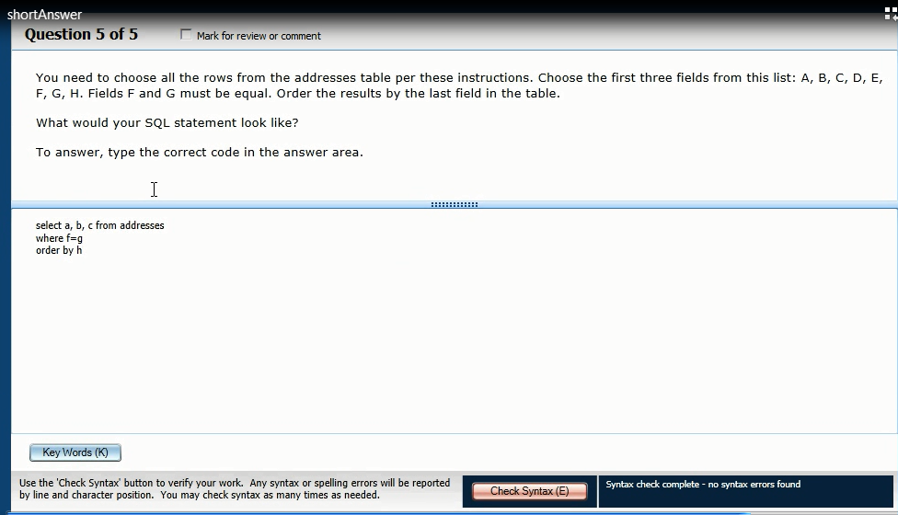
Test Question Format
Short Answer Code

Slide 30
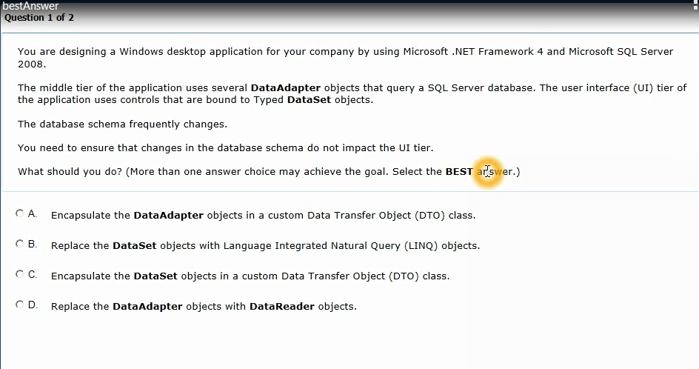
Test Question Format
Best Answer
More than one answer may be correct.

Slide 31
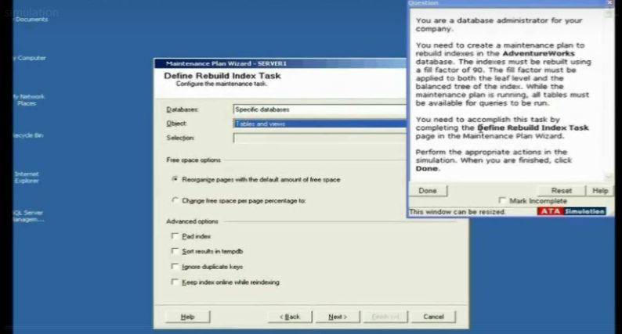
Test Question Format
Simulation

Slide 32
More on Test Question Formats
On average 40-60 questions, more for CompTIA and Cisco
  One of my Microsoft MCITP exams had 88 lengthy story problems
One test question per screen page
  Some questions have “Exhibits” which are one or more pictures that provide insight into answering the question (like a configuration screenshot)
Some tests (most) allow you to return to previous questions, and to review marked questions before ending the exam
Tip #5: look for opposites, exceptions, and look for patterns in answers

Slide 33
Exam Tip #6:
Of Course, Some of the Test Answers
Are Made to Look Legitimate
i.e., a test question may suggest running “CHECKDOMAIN.EXE /C” before running DCPROMO.
  But there’s no such command!

Slide 34
Exam Tip #7:
Use the Process of Elimination
My (Corny) Conventions
  A no way, can’t be the answer
  B not sure if it’s the answer
  (no mark placed)
  C not likely the answer
  D very likely the answer
X
/

Slide 35
Exam Tip #8:
Put Your Best Effort Forth to Answer Each Question on the First Pass Through the Test
…Even though some tests permit question review

Slide 36
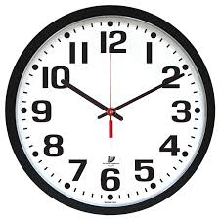
Exam Tip #9:
Manage Your Testing Time
I have been very time-challenged in my “recent” exams
Determine the number of questions to be completed by the half-way point
Check your watch a few times during the test, especially at half-way and maybe hourly

Slide 37
Exam Tip #10:
Aim to Pass the Exam on the First Try
Plan on visiting each question only once, so…
Make your first answer your best answer
Remember, “P” is for “Pass”
  Certifications don’t include your test scores

Slide 38
Exam Tip #11:
What time of the day should you take the exam?
Choices: morning, afternoon, (sometimes) evening
The test center may dictate their availability
It depends on your biological or body clock
Not usually at the end of the work day (but I’ve done it multiple times)
Not right after lunch
I like the morning to get it over with and because I’m the freshest

Slide 39

It’s Not a Perfect
Testing World…
Expect the Following:
No Correct Answer on a Question
More Than One Correct Answer
Not Enough Detail Provided
Remember, Select the Best Answer

Slide 40
Testing “Old Wives Tales”
Lots of rumors surround the test scoring process.
If the vendor doesn’t clearly state something as fact then it may not be fact, such as…
  Whether or not the test is “adaptive”
  Are questions “weighted”
The testing vendors don’t explain the exam scoring methodology
  Partial credit?
  Adaptive tests?

Slide 41
Totally Obvious
Test-Taking Tips, Part 1
Tip #12: Know Your Product Well
  Read your courseware completely through, maybe twice
  Hands-on practice with the product is mandatory to obtain product mastery
    Consider running each lab 2-3 times
Tip #13: Be Calm, Try to stay calm
Tip #14: Come well rested; don’t pull an
“all-nighter” the night before the exam
Tip #15: As you answer a question, in general, go with your first impression

Slide 42
Totally Obvious
Test-Taking Suggestions,
Part 2
Tip #16: Read the question very carefully, and answer the specific question. Don’t rush!
Tip #17: When permitted to return to previous questions, leverage previous questions to answer future questions.
Tip #18: When you have >1 test to take for a certification track consider taking the easiest exam first to build your confidence

Slide 43

Some Tests Allow Feedback
Mark questions for review and/or comment during the exam
Provide feedback (comments) on marked questions at the end of the exam
For example:
  Some test questions are incomplete
  Some test questions are have no correct answers
    “Trial” test questions

Slide 44

Testing Trends
Much harder exams
More clever exam questions
Broader test question formats
Test questions diverge greater from the related course material

Slide 45
Upon Completing Certification
(What to Expect)
Expect email
Per the email above you may have to order your certificate rather than receive it automatically

Slide 46
Let’s Look at Some Sample Questions for 70-463
Notes:
This slide is for a live presentation only.

Slide 47

Go Get ‘em!
I dare you!
I love to hear about your successes and your missed attempts.
Let me know via email about your test experience!

